Slide 1
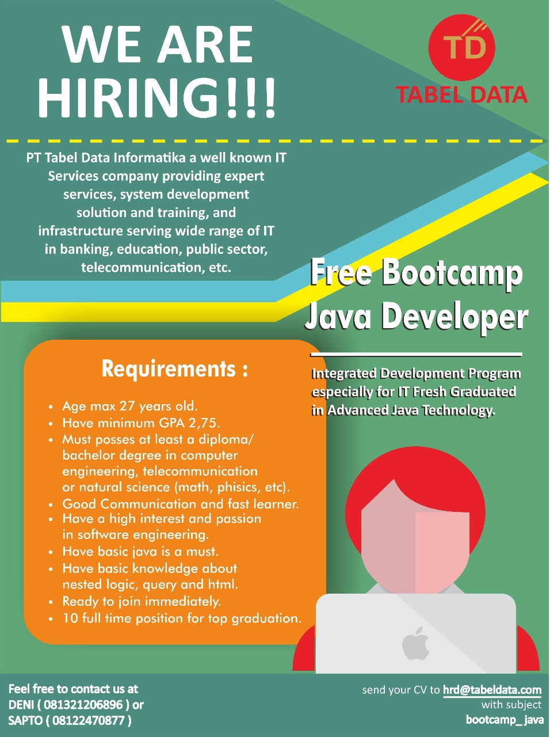
Bootcamp Java Developer #Day 1
PT. Tabel Data Infromatika
By Dimas Maryanto,S.Kom

Slide 2
Java Web dengan Servlet dan JSP
A servlet is a small Java program that runs within a Web server. Servlets receive and respond to requests from Web clients, usually across HTTP, the HyperText Transfer Protocol.
A JSP page is a text document that contains two types of text: static data, which can be expressed in any text-based format (such as HTML, SVG, WML, and XML), and JSP elements, which construct dynamic content.

Slide 3
HTTP Method
GET
POST
PUT
DELETE

Slide 4
HTTP Status
Information response
100 Continue
101 Switching Protocol
Successfull response
200 OK
201 Created
202 Accepted
204 No Content
Redirction messages
300 Multiple Choice
301 Moved Permanently
302 Found
Client error responses
400 Bad Request
401 Unauthorized
403 Forbidden
404 Not Found
405 Method Not Allowed
408 Request Timeout
415 Unsupported Media Type
429 Too Many Request
Server error responses
500 Internal Server Error
501 Not Implemented
502 Bad Gateway

Slide 5
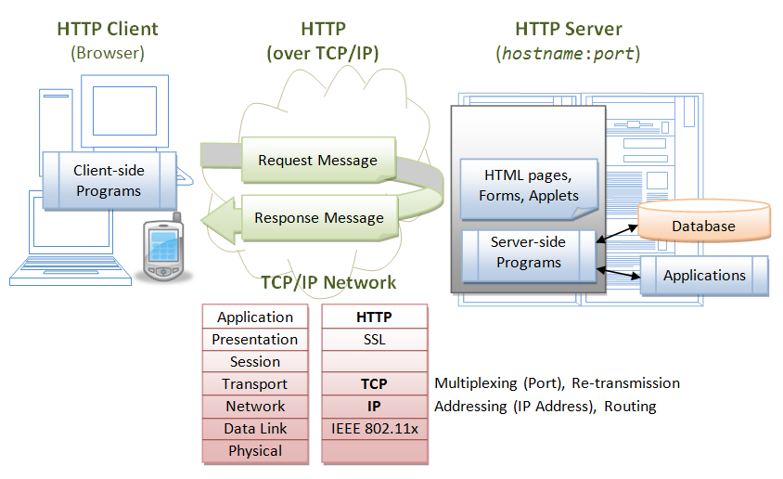
Web Server Processing JSP & Servlet
sumber: (https://www.ntu.edu.sg/home/ehchua/programming/java/JavaServlets.html)

Slide 6




Web Server untuk Java

